Slide 1

BASIC JAVA CLASS-5
SALMAN RAHMAN
ROAD TO SDET

Slide 2
CONTENTS
File read and write
JSON data write
JSON Read data
JSON List write
JSON Read from List data
JSON Update
JSON List update
JSON Delete from list

Slide 3
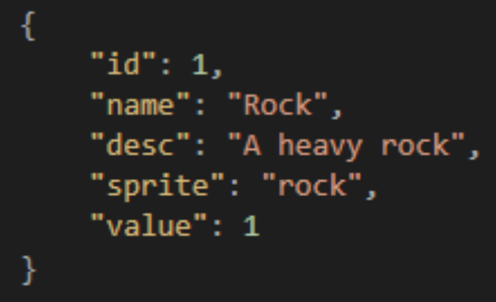
JSON Architecture
{ "name“ : "Shouvik",
"age“ : 25,
"address“ : {
"city“ : "Dhaka“ ,
"zip“ : "1207“
}
}
Array of JSON
[ {} , {} , {} , {} ]

Slide 4
JSON CONFIGURATION
Create Gradle Project
Add dependency to build.gradle under dependency tag
// https://mvnrepository.com/artifact/com.googlecode.json-simple/json-simple
implementation group: 'com.googlecode.json-simple', name: 'json-simple', version: '1.1.1'

Slide 5
FILE WRITE
// Create a file Named “test.txt” in resources folder.
public static void writeFile() throws IOException {
FileWriter fw = new FileWriter("./src/main/resources/test.txt"); fw.write("Hello World"); fw.close();
}
// Now change the write text and see how it overrides previous one.

Slide 6
FILE WRITE [ Skipping overiding]
// Just add a true in the FileWriter constructor
FileWriter fw = new FileWriter("./src/main/resources/test.txt”
, true ); fw.write("\nHello World"); fw.close();

Slide 7
FILE READ
public static void readFile() throws IOException {
FileReader fr = new FileReader("./src/main/resources/test.txt"); // Returns ASCII value of first character // System.out.println( fr.read() ); int characters ; while( ( characters = fr.read() ) != -1 ) { System.out.print( (char) characters ); }
}

Slide 8
File Read alternative option
public static void main(String[] args) throws IOException {
Path filePath = Paths.get("./src/main/resources/test.txt");
try {
String content = Files.readString(filePath); // Java 11+
System.out.println(content);
} catch (IOException e) {
e.printStackTrace();
}
}

Slide 9
JSON WRITE
public static void main(String[] args) throws IOException {
JSONObject jsonObject = new JSONObject();
jsonObject.put( "id" , 1 );
jsonObject.put( "name", "Rock" );
jsonObject.put( "designation" , "SDET" );
System.out.println(jsonObject);
FileWriter fw = new FileWriter("./src/main/resources/employee.json");
fw.write( jsonObject.toJSONString() );
fw.flush();
fw.close();
}
Create an “employee.json” file in the
resources folder.
Ctrl + alt + L
To Beautify the format of json file

Slide 10
JSON READ
public static void jsonRead() throws IOException, ParseException {
JSONParser jsonParser = new JSONParser(); JSONObject jsonObject = (JSONObject) jsonParser.parse( new FileReader("./src/main/resources/employee.json")); String employeeName = (String) jsonObject.get("name"); System.out.println( employeeName ); }

Slide 11
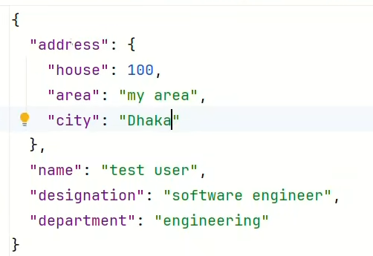
JSON WRITE
public static void jsonWrite() throws IOException { JSONObject empObject = new JSONObject(); empObject.put("name" , "Shouvik"); empObject.put("designation", "SDET"); empObject.put("department","Engineering"); JSONObject addressObj=new JSONObject(); addressObj.put("houseNo", "100"); addressObj.put("area", "my area"); addressObj.put("city", "Dhaka");
empObject.put("address", addressObj); FileWriter fw=new FileWriter("./src/main/resources/employee.json"); fw.write(empObject.toJSONString()); fw.flush(); fw.close();
}

Slide 12
JSON READ
public static void jsonRead() throws IOException, ParseException { JSONParser jsonParser = new JSONParser(); JSONObject jsonObject = (JSONObject) jsonParser.parse( new FileReader("./src/main/resources/employee.json")); String employeeName = (String) jsonObject.get("name"); System.out.println( employeeName ); JSONObject addrress = (JSONObject) jsonObject.get("address"); System.out.println(addrress); String city = (String) addrress.get("city"); System.out.println(city); }

Slide 13
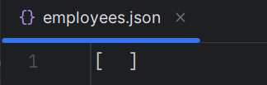
WRITE JSON LIST
public static void writeJSONArray() throws IOException, ParseException { String fileName = "./src/main/resources/employees.json"; JSONParser jsonParser = new JSONParser(); JSONArray employees = (JSONArray) jsonParser.parse(new FileReader(fileName)); JSONObject jsonObject = new JSONObject(); jsonObject.put("id", 1); jsonObject.put("name", "Shouvik"); jsonObject.put("designation", "SQA"); jsonObject.put("address", "Dhaka"); employees.add(jsonObject); FileWriter fw = new FileWriter(fileName); fw.write(employees.toJSONString()); fw.flush(); fw.close(); }
Create a file named “emplyees.json” in the resources folder.
Initiate the file with an empty array : [ ]
Run this code 2/3 times to see multiple objects adding to array.

Slide 14
READ FROM JSON ARRAY
public static void readJSONArray() throws IOException, ParseException { String fileName = "./src/main/resources/employees.json"; JSONParser jsonParser = new JSONParser(); JSONArray employees = (JSONArray) jsonParser.parse(new FileReader(fileName)); JSONObject jsonObject = (JSONObject) employees.get(0); String name = (String) jsonObject.get("name"); System.out.println(name); }

Slide 15
UPDATE JSON [Single Object]
public static void updateJSON(String key, String value) throws IOException, ParseException { String fileName="employee.json"; JSONParser jsonParser = new JSONParser(); Object obj = jsonParser.parse(new FileReader(fileName)); JSONObject empObj = (JSONObject) obj; System.out.println(empObj); empObj.put(key,value); FileWriter file = new FileWriter(fileName); file.write(empObj.toJSONString()); file.flush(); file.close(); System.out.println("Updated!"); System.out.print(empObj); }

Slide 16
UPDATE JSON [ LIST DATA ]
public static void updateJSONList(int index, String key, String value) throws IOException, ParseException {
String fileName="./src/main/resources/student.json";
JSONParser jsonParser = new JSONParser();
Object obj = jsonParser.parse(new FileReader(fileName));
JSONArray jsonArray = (JSONArray) obj;
JSONObject jsonObject = (JSONObject) jsonArray.get(index);
jsonObject.put(key, value);
FileWriter file = new FileWriter(fileName);
file.write(jsonArray.toJSONString());
file.flush();
file.close();
System.out.println("Updated!");
System.out.print(jsonArray); }

Slide 17
DELETE JSON DATA
public static void deleteJSONList(int index) throws IOException, ParseException { String fileName="student.json"; JSONParser jsonParser = new JSONParser(); Object obj = jsonParser.parse(new FileReader(fileName)); JSONArray jsonArray = (JSONArray) obj; jsonArray.remove(index); FileWriter file = new FileWriter(fileName); file.write(jsonArray.toJSONString()); file.flush(); file.close(); System.out.println(“Deleted!"); System.out.print(jsonArray); }

Slide 18
Search data from JSONArray
public static JSONObject searchJSONArray(String searchId) throws IOException, ParseException, ParseException { String filePath="./src/main/resources/employees.json"; JSONParser parser=new JSONParser(); JSONArray jsonArray= (JSONArray) parser.parse(new FileReader(filePath)); for(Object obj: jsonArray){ JSONObject jsonObject= (JSONObject) obj; String id= jsonObject.get("id").toString(); if(id.equals(searchId)){ return jsonObject; } } return new JSONObject(); } public static void main(String[] args) throws IOException, ParseException { JSONObject jsonObject = searchJSONArray("1"); System.out.println( jsonObject ); }

